Slide 1
Designing a Realistic ML System for Spam Classification
CS4981 ML Production Systems
RJ Nowling

Slide 2
Goals
Design ML-based system for identifying spam
Justify design with insights from running production machine learning systems
Use an iterative process

Slide 3
Data Set
trec07p – University of Waterloo
~ 75k emails from between April and July 2007
~25k ham
~50k spam
Used 75% for training, 25% for testing

Slide 5
Dear Class, I've uploaded the new homework to D2L. It's due on Monday. I'm looking forward to seeing your solutions! RJ
?
[0, 1, 0, 0, 0, 1, 1, 0, 0]

Slide 6
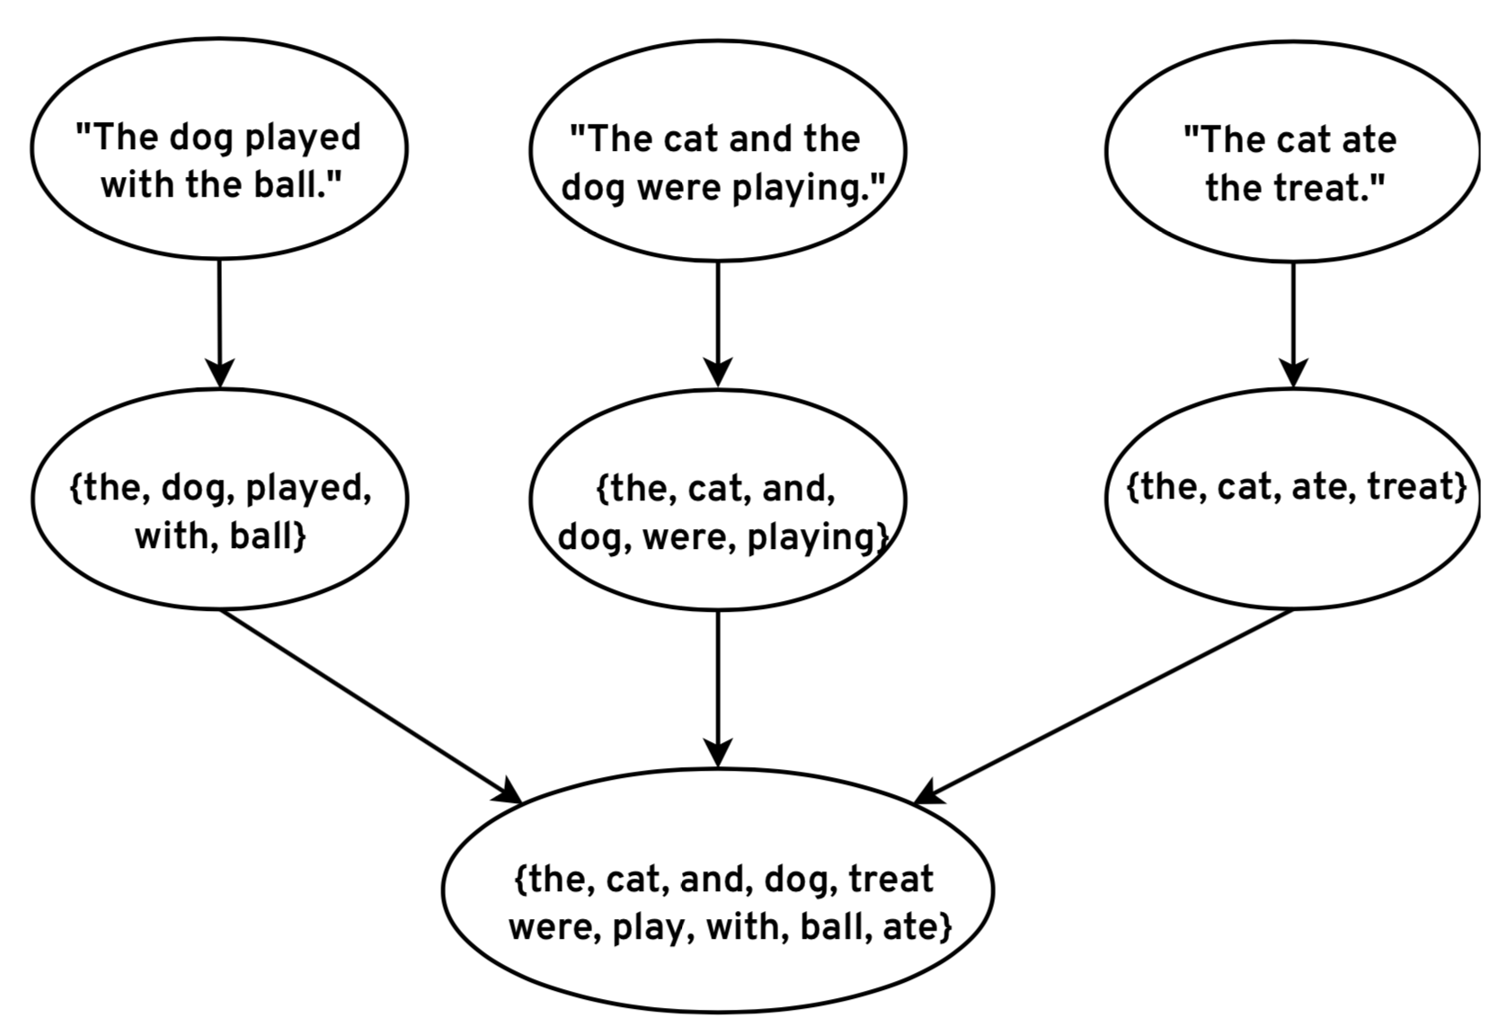
Extract Vocabulary

Slide 7
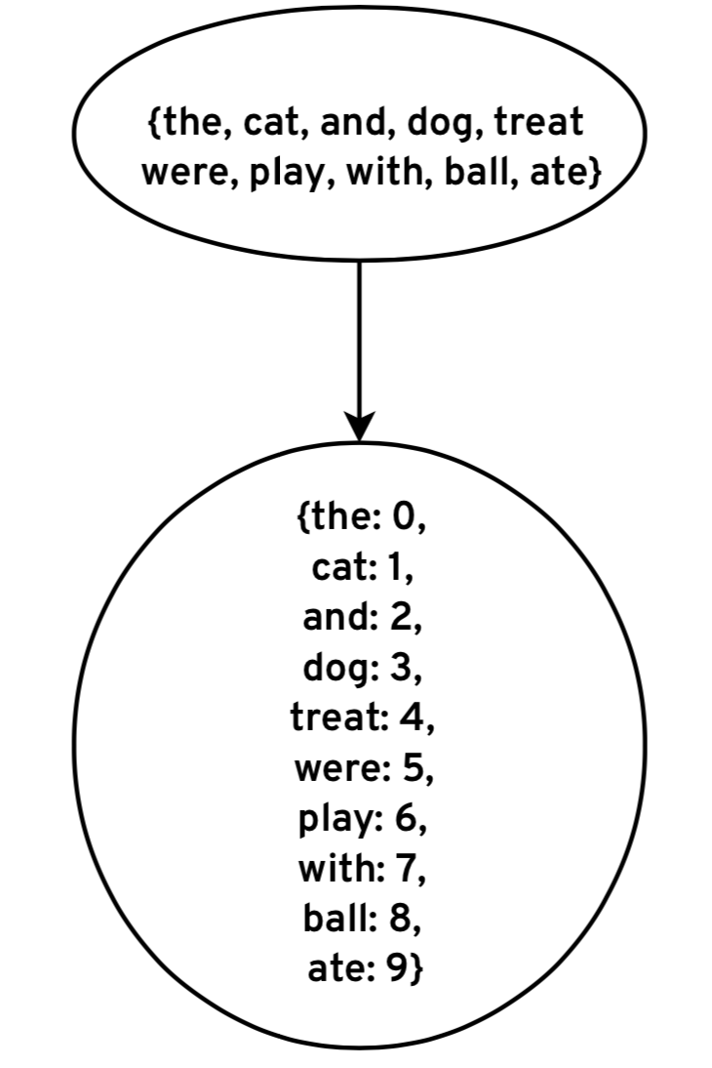
Map Words to Column Indices

Slide 8
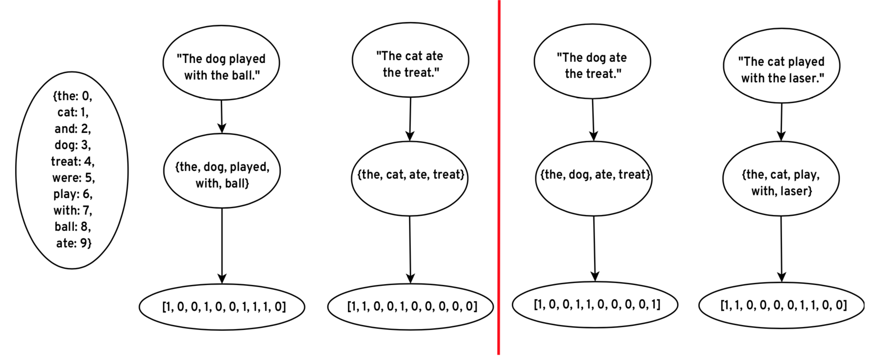
Encode Features

Slide 9
Encode Features

Slide 10
Lesson #1
Raw data needs to be transformed into features;
feature engineering code and state needs to be deployed along with the model

Slide 12
Choosing a Classification Algorithm
Output type (binary vs probability)
Ease of Achieving High Accuracies
Interpretability

Slide 13
Choosing an Algorithm
Output type (binary vs probability)
Ease of Achieving High Accuracies
Interpretability
Resources (time, CPU, GPU, memory, storage) needed for training and prediction
Resulting model size
Availability (or ease) of implementation and maintenance

Slide 14
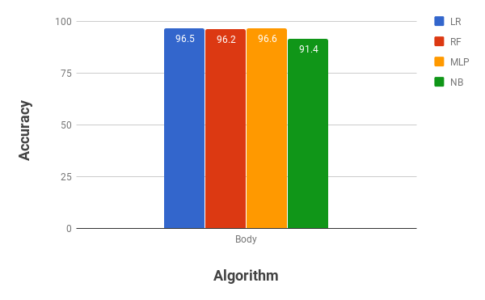

Slide 15
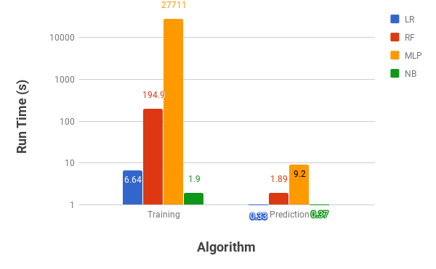

Slide 16
Lesson #2
We need to consider factors beyond accuracy when choosing which ML algorithms to use

Slide 17
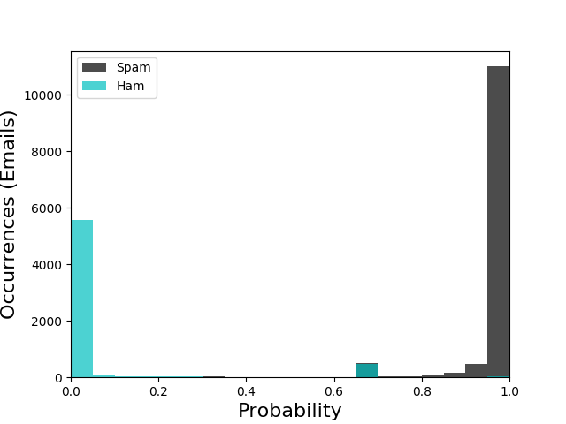

Slide 18
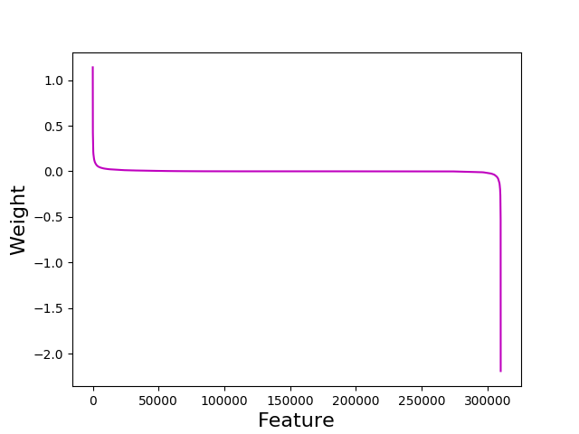
Feature Weights

Slide 19
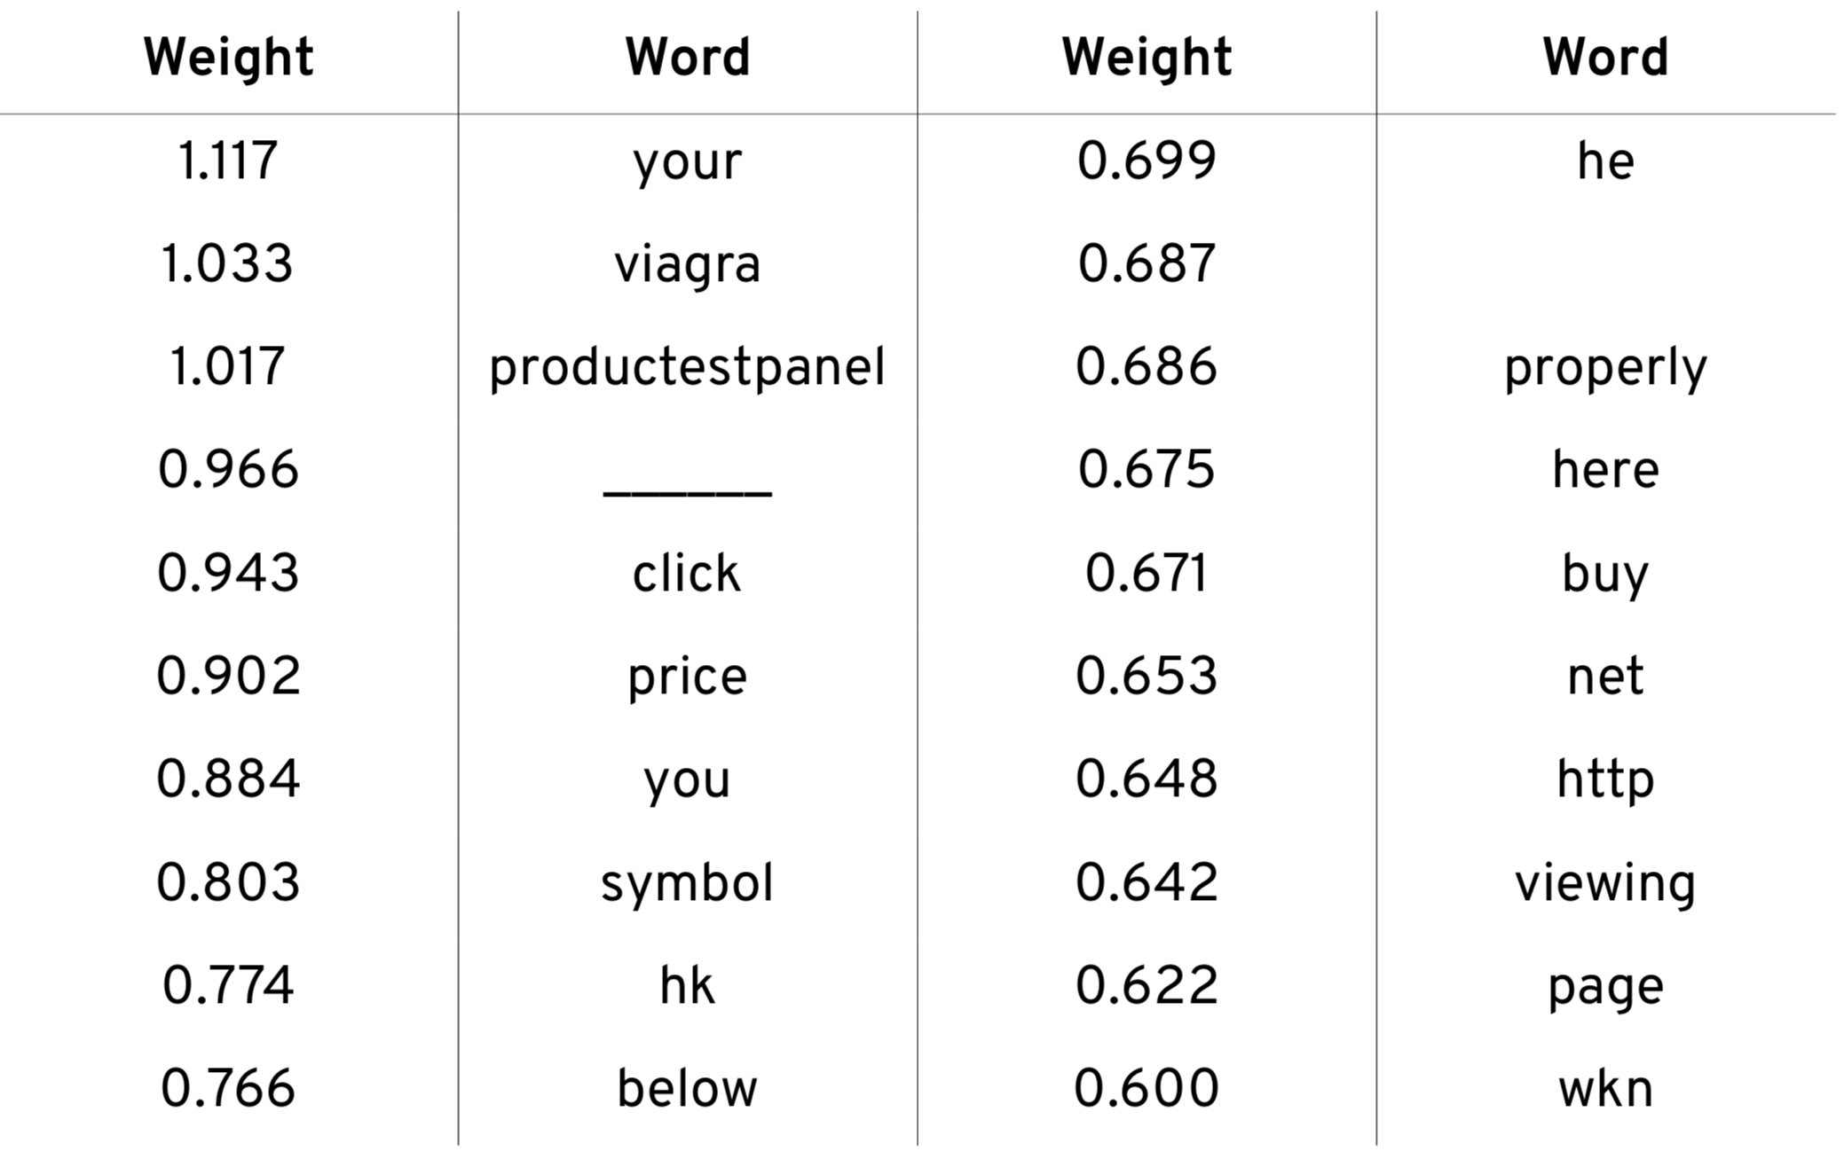

Slide 20
From xlvwscs@net.il Wed Apr 11 21:18:50 2007
Return-Path: xlvwscs@net.il
Received: from DSL217-132-183-148.bb.netvision.net.il (89-139-22-235.bb.netvision.net.il [89.139.22.235])
by speedy.uwaterloo.ca (8.12.8/8.12.5) with ESMTP id l3C1Im0I024199
for <gnitpick@speedy.uwaterloo.ca>; Wed, 11 Apr 2007 21:18:49 -0400
From: "repairs" xlvwscs@net.il
To: gnitpick@speedy.uwaterloo.ca
Subject: Secure Web-Form
Date: Thu, 12 Apr 2007 04:18:33 -0300
MIME-Version: 1.0
Content-Type: multipart/related;
boundary="----=_NextPart_000_0004_01C77CB9.A20DDD00"
X-Mailer: Microsoft Office Outlook, Build 11.0.5510
Thread-Index: Acd8uaINCus5OCPWRZ2d2pVdMAveNQ==
X-MimeOLE: Produced By Microsoft MimeOLE V6.00.2900.2869
Message-Id: <FC6B2A13C68B036.F7152FB58C@net.il>

Slide 21
From: "repairs" xlvwscs@net.il
X-Mailer: Microsoft Office Outlook, Build 11.0.5510

Slide 22
Domains
net.il => { net.il, il }
amazon.co.uk => { amazon.co.uk, co.uk, uk }
User Agents
Microsoft Office Outlook, Build 11.0.5510 =>
{ microsoft, office, outlook, build, 11, 0, 5510 }
Thunderbird 1.5 (Windows/20051201) =>
{ thunderbird, 1, 5, windows, 20051201 }

Slide 23
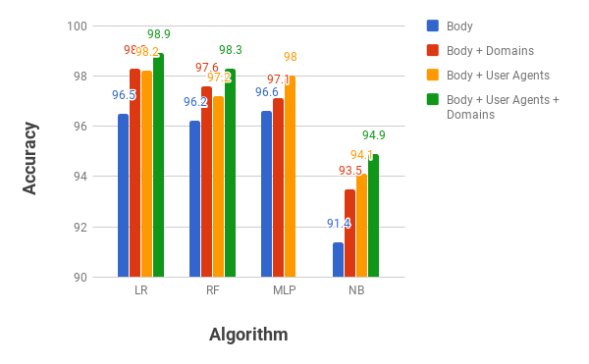

Slide 24
Lesson #3
Most model improvements come from new features, not new algorithms

Slide 25
Human Feedback
Look at user interactions to evaluate how well the product works for the user
Spam ends up in inbox (false negative)
User never reads
User deletes without reading
User deletes quickly after reading
User clicks on unsubscribe link in email
Ham ends up in spam folder (false positive)
User moves email from spam folder to inbox

Slide 27
Lesson #4
Model accuracy alone doesn't guarantee desirable behavior in the product;
Need to measure business- or user-focused metrics as well

Slide 29
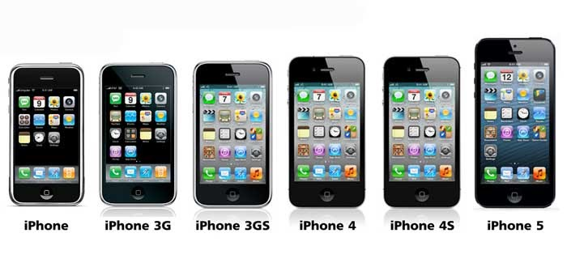
https://sites.google.com/site/jjjcphone/iphone-evolution
Notes:
Data changes over time
Need a sustainable source of new labeled data
Need to continually update training sets
Need to retrain transform and models periodically – as often as every few hours!
Automate it!

Slide 30
Apple is pleased to announce the release of its new iPhone X. The iPhone X includes the new FaceID feature – unlock your phone with just a glance.
Buy the new iPhone X for 25% off!!! Special price for special customers. Straight from the factory. Don't miss this incredible offer!!!

Slide 31
Lesson #5
Data will most likely change over time;
ML components need to be updated periodically and automatically

Slide 33
Testing Models
Machine learning can fail
Data can become corrupted
Malicious data designed to disrupt model
Software bugs
Blind automated deployment can lead to disasters

Slide 34
Lesson #6
We need to test models
just like we test code

Slide 36
Conclusions
Modeling is only part of building a production ML-based systems
Modeling decisions (e.g., algorithm choices) need to take system requirements and constraints into account
Designing and building a ML system requires a "holistic", integrative view

Slide 37
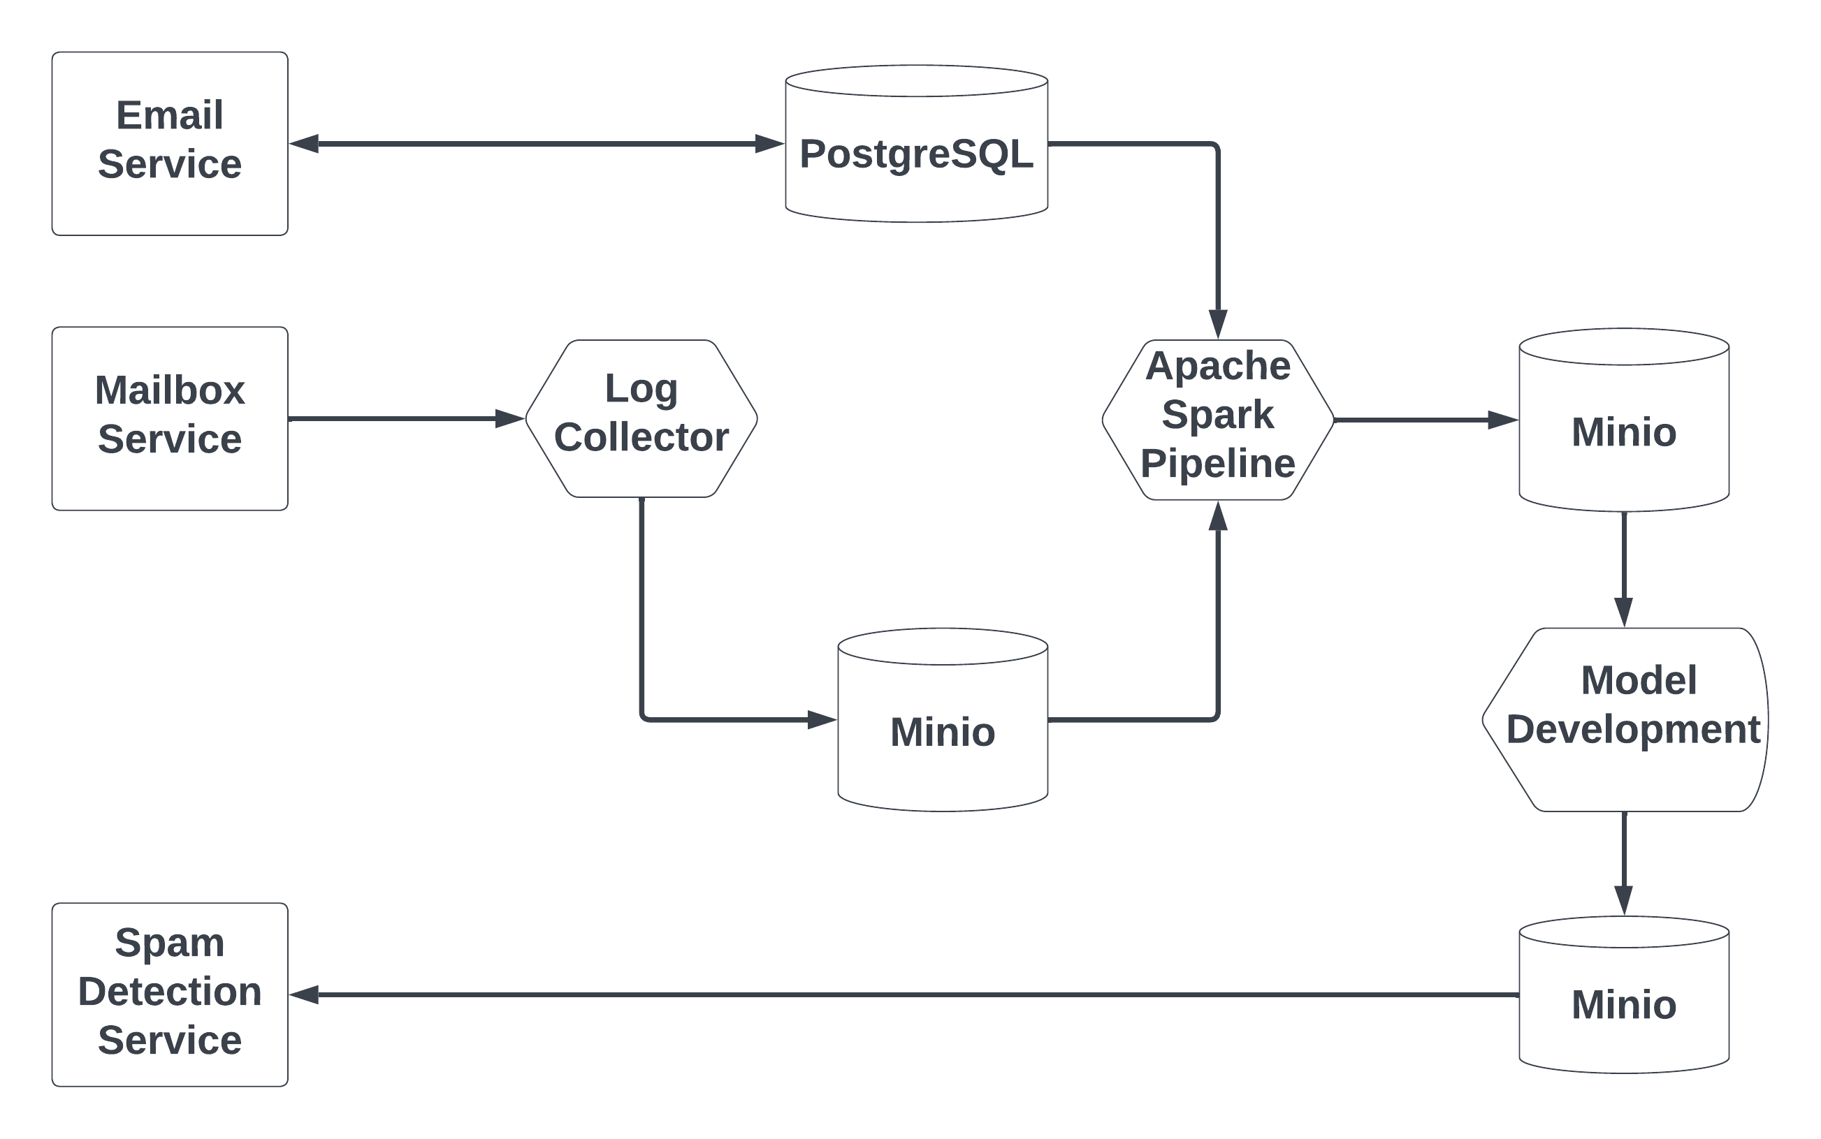
Class Project

Slide 38
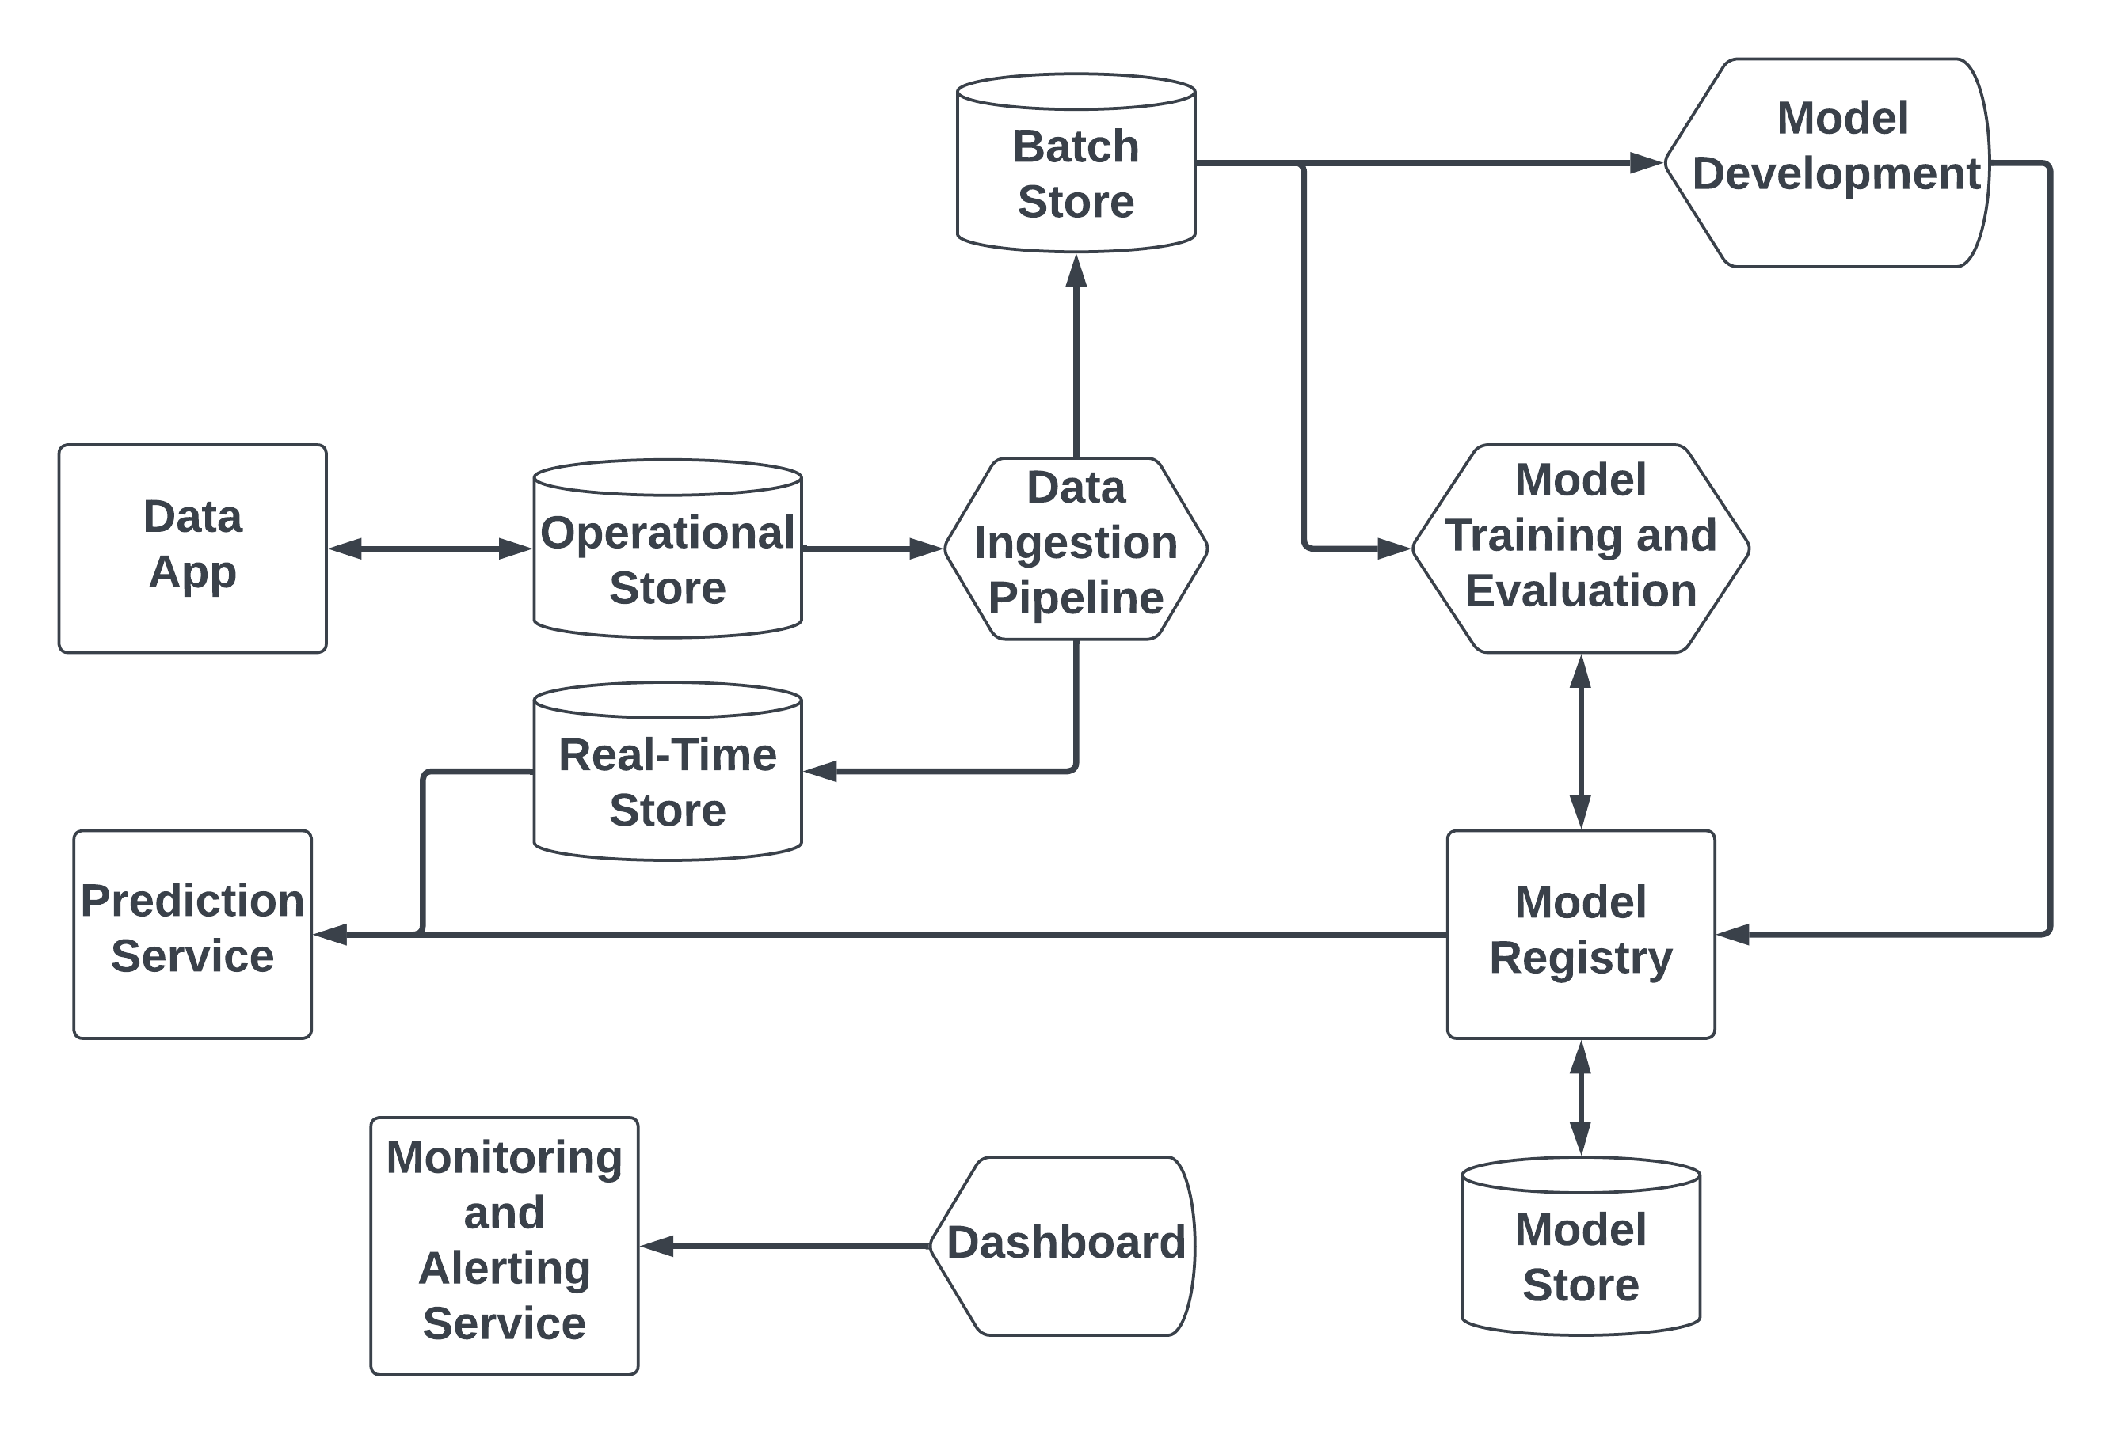
Generalized Architecture
Microblogging platform (people or tags to follow)
Product recommendation system
Real estate value estimator
Fraud detector

